Slide 1
بِسمِ اللہِ الرَّحمٰنِ الرَّحِيم

Slide 2
PROGRAMMING FUNDAMENTALS FINAL PROJECT
GROUP MEMBERS
ANSAR AHMAD # 42916
m SARMAD RAFIQ # 43631
Bscs-1b
Spring-2022
Riphah School of Computing & Innovation

Slide 3
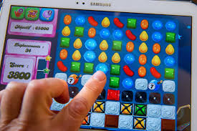
Project Name Candy crush
(Without graphics)

Slide 4
Used Functions:
void Map_Load(char [ ][COL]);
void Loading_Page(char [ ][COL]);
void instructions(char[ ][COL]);
void Insert_Steric(char[ ][COL]);
void swapping(char[ ][COL]);
void rewrite(char[ ][COL]);
void move_cursor_to_xy(int, int);
void result();

Slide 5
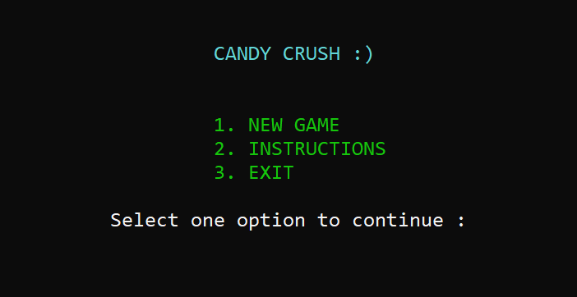
Main menu

Slide 6
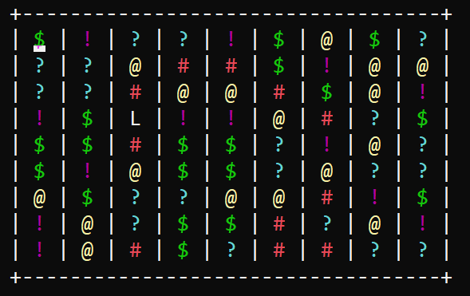
Game interface

Slide 7
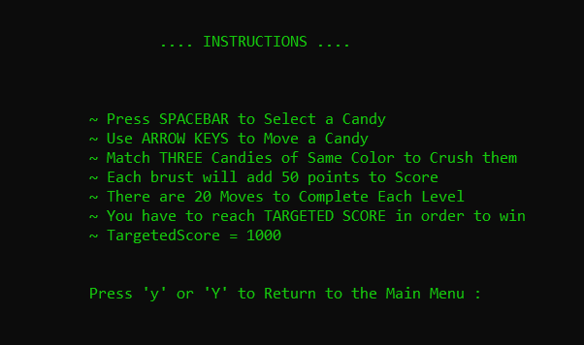
Instructions

Slide 8
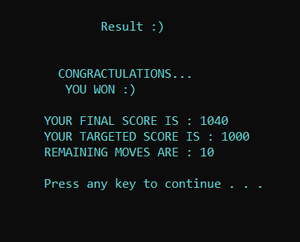
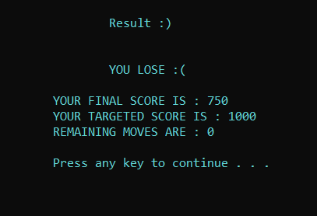
results

Slide 9
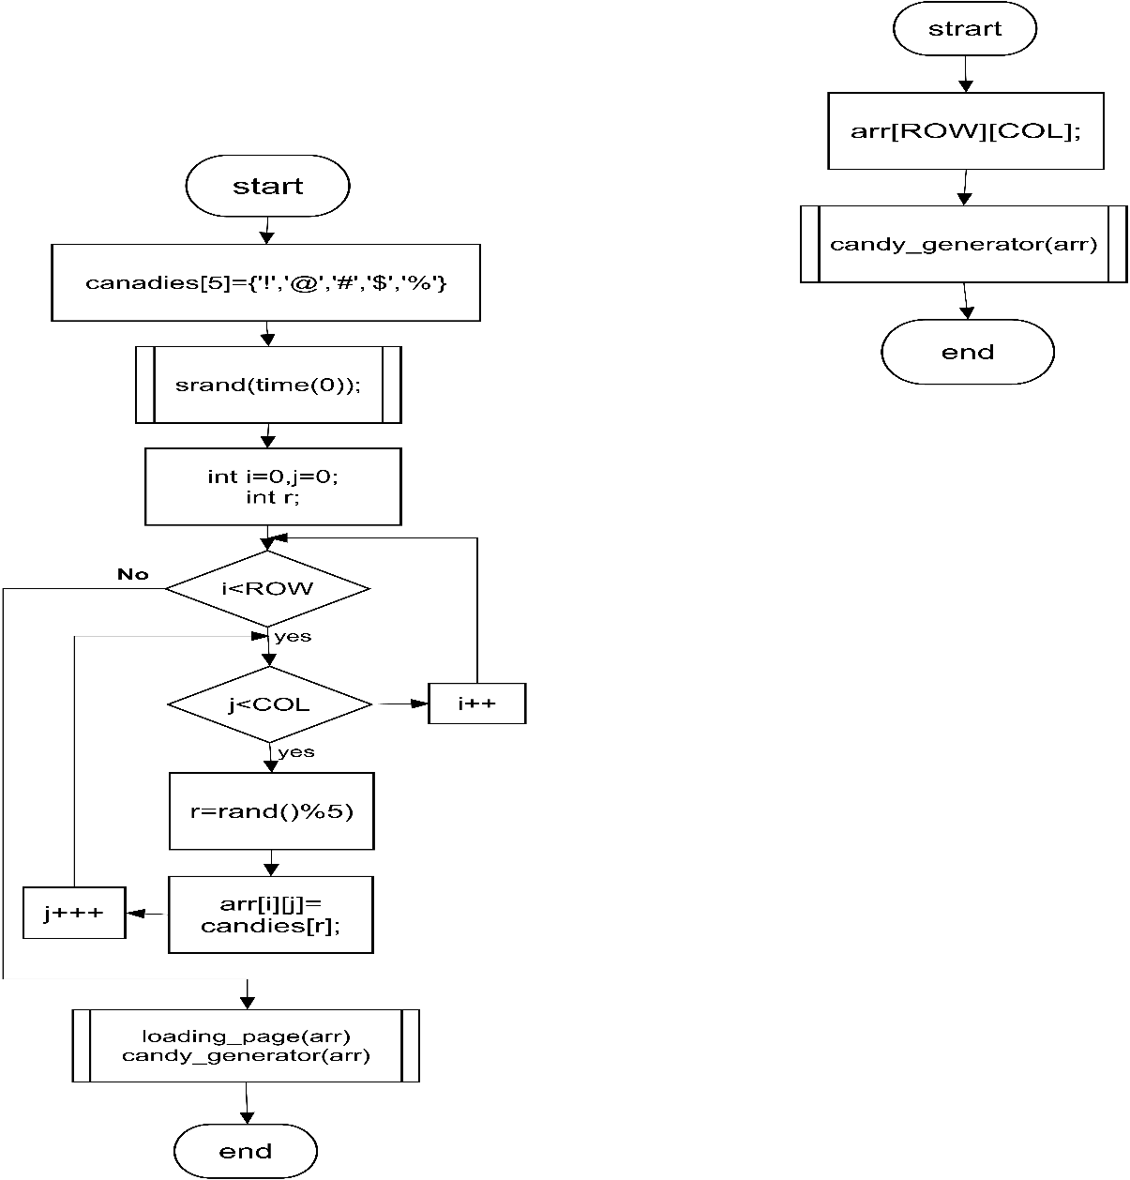
Flow charts Main_Body( )

Slide 10
Thank you
(:

